Slide 1
Linked list I
SESSION 03
Henry Lucky, S.Kom., M.Kom.

Slide 2
LEARNING OUTCOMES
Session 03
The learning outcomes associated with this topic:
LO 1: Explain the concept of data structures and its usage in Computer Science
LO 2: Illustrate any learned data structure and its usage in application
LO 3: Apply data structures using C

Slide 3
LEARNING Objectives
Session 03
At the end of this session, students will be able to:
Understand the concept of Linked List
Explain the difference between Linked List and Array
Apply the Single Linked List using C

Slide 4
SUBTOPICS
Session 03
Linked List Introduction
Linked List vs Array
Single Linked List

Slide 5
Linked list introduction
concept
Linked list is a data structure that consists of a sequence of data records such that each record there is a field that contains a reference to the next record in the sequence.
Linked list allows insertion and deletion of any element at any location.
Linked list is used in many algorithms for solving real-time problems, when the number of elements to be stored is unpredictable and also during sequential access of elements.

Slide 6
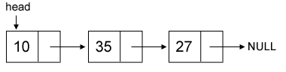
Linked list introduction
concept
Take a look at the following figure:
Example of a list whose nodes contain two fields:
an integer value & a link to the next node.
Linked list which node contain only a single link to another node is called single linked list.

Slide 7
Linked list vs array
concept
Array:
Linear collection of data elements
Store value in consecutive memory locations
Can be random in accessing of data
Linked List:
Linear collection of nodes
Doesn’t store its nodes in consecutive memory locations
Can be accessed only in a sequential manner

Slide 8
Single Linked list
Dynamic Memory allocation
If you need to allocate memory dynamically (in runtime), you can use malloc in C/C++.
To de-allocate you can use free.

Slide 9
Single Linked list
concept
To create a linked list, we first need to define a node structure for the list.
Supposed we want to create a list of integers.
head is the pointer to the
first element in our linked list.

Slide 10
Single Linked list
insert
To insert a new value, first we should dynamically allocate a new node and assign the value to it and then connect it with the existing linked list.
Supposed we want to append the new node in front of the head.
struct tnode *node = (struct tnode*) malloc(sizeof(struct tnode)); node->value = x; node->next = head; head = node;

Slide 11
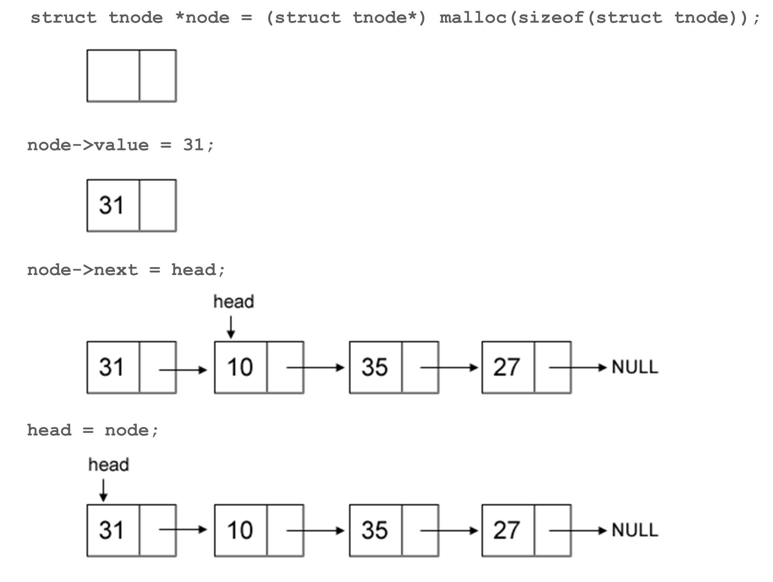
Single Linked list
insert

Slide 12
Single Linked list
insert
How about the algorithm of inserting new node in the middle and in the last of the single linked list?
Try it by yourself!

Slide 13
Single Linked list
delete
To delete a value, first we should find the location of node which store the value we want to delete, remove it, and connect the remaining linked list.
Supposed the value we want to remove is x and assuming x is exist in linked list and it is unique.
There are two conditions we should pay attention to:
if x is in a head node or
if x is not in a head node.

Slide 14
Single Linked list
delete
struct tnode *curr = head; // if x is in head node if ( head->value == x ) { head = head->next; free(curr); } // if x is not in head node, find the location else { while ( curr->next->value != x ) curr = curr->next; struct tnode *del = curr->next; curr->next = del->next; free(del); }

Slide 15
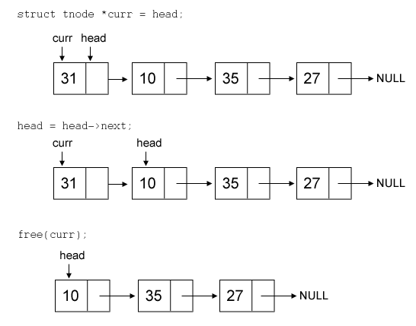
Single Linked list
delete
Delete 31 (at head)

Slide 16
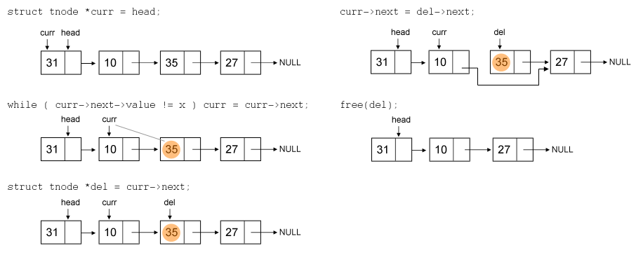
Single Linked list
delete
Delete 35 (not at head)

Slide 17
Summary
Linked list is useful, especially in solving real-time problems where the number of elements to be stored is unpredictable and also during sequential access of elements.
Linked List has two types, single and double linked list.
Single linked list is characterized by having a single one way link from a list pointing to another list

Slide 18
References
S. Sridhar. 2015. Design and Analysis of Algorithms. Oxford University Press. New Delhi. ISBN: 9780198093695. Chapter 5
Reema Thareja. 2014. Data structures using C. Oxford University Press. New Delhi. ISBN:9780198099307. Chapter 6
Thomas H. Cormen, Charles E. Leiserson, Ronald L. Rivest, & Clifford Stein. (2022). Introduction to Algorithms. 04. The MIT Press. London. ISBN: 9780262046305. Chapter 10.
Linked List, https://visualgo.net/en/list?slide=3

